Slide 1
DR.SNSRCAS, CBE
SUBJECT: CLOUD TECHNOLOGY FUNDAMENTALS
COURSE CODE:21UCA501 UNIT - IV
TITLE: The Google APIs
YEAR: III SEMESTER 2022-2023 (ODD)

Slide 2
Google APIs
Most Google services are exposed by an API, which is why you find a version of Google’s search engine, Google Maps, YouTube videos, Google Earth, AdWords, AdSense, and even elements of Google Apps exposed in many other Web sites.

Slide 3
Google APIs
You can get to the listing of the Google APIs by clicking the More Products link on the Code page.

Slide 4
Google APIs
Google’s APIs can be categorized as belonging to the following categories:
1) Ads and AdSense
2) AJAX
3) Browser
4) Data
5) Geo
6) Search
7) Social

Slide 5
Google Analytics
According to Builtwith.com (http://trends.builtwith.com/analytics/Google-
Analytics), Google Analytics was in use on 54 percent of the top 10,000 and 100,000, and 35
percent of the top one million of the world’s Web sites.
Builtwith.com speculates that Google
Analytics JavaScript tag is the most widely used URL in the world today.

Slide 6
Google APIs
1) Ads and AdSense: These APIs allow Google’s advertising services to be integrated into Web applications.
The most commonly used services in this category are AdWords, AdSense, and Google Analytics.

Slide 7
Google APIs
2) AJAX: The Google AJAX APIs provide a means to add content such as RSS feeds, maps, search boxes, and other information sources by including a snippet of JavaScript into your code.

Slide 8
Google APIs
3) Browser: Google has several APIs related to building browser-based applications, including four for the Chrome browser. This category includes the Google Cloud Print API, the Installable Web Apps API for creating installation packages, the Google Web Toolkit for building AJAX applications using Java, and V8, which is a high-performance JavaScript engine.

Slide 9
Google APIs
4) Data: The Data APIs are those that exchange data with a variety of Google services. The list of Google Data APIs includes Google Apps, Google Analytics, Blogger, Bas, Book, Calendar, Code Search, Google Earth, Googl Spreadsheets, Google Notebook, and Picasa Web Albums.

Slide 10
Google APIs
5) Geo: A number of APIs exist to give location-specific information hooking into maps and geo-specific databases. Some of the more popular APIs in this category include Google Earth, Directions, Java Scripts Maps, Maps API for Flash, and Static Maps.

Slide 11
Google APIs
6) Search: The search APIs leverage Google’s core competency and its central service. APIs such as Google AJAX Search, Book Search, Code Search, Custom Search, and Webmaster Tools Data APIs allow developers to include Google searches in their applications and web
sites.

Slide 12
Google APIs
6) Social: Many Google APIs are used for information exchange and communication tools. They support applications such as Gmail, Calendar, and others, and they provide a set of foundation services. The popular social APIs are Blogger Data, Calendar, Contacts, Open Social, Picasa, and YouTube.

Slide 13
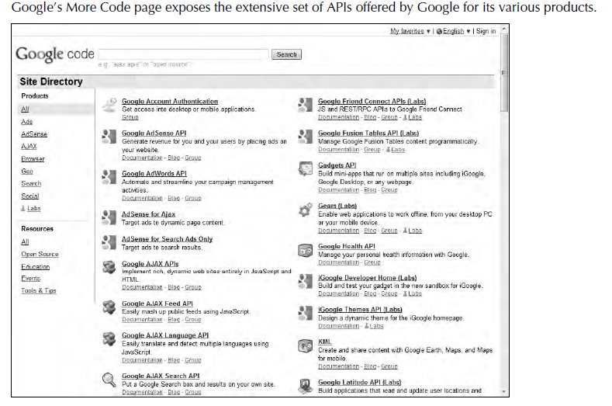

Slide 14
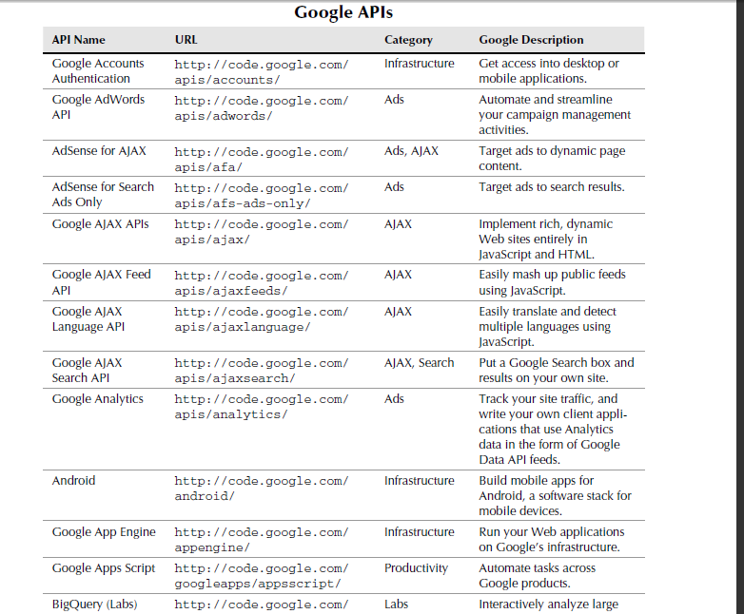

Slide 15
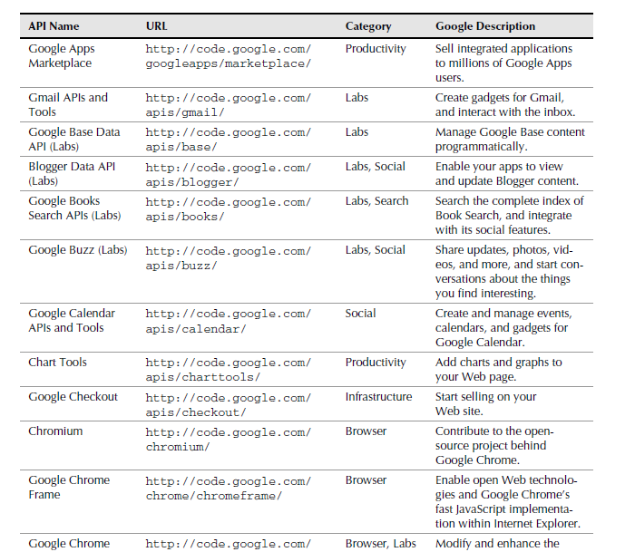

Slide 16
Thank You

